Slide 1
JD+ 3.0
Core algorithms

Slide 2
What’s new in JD+ 3.0?
Additional time series domains
New concepts
Design
API / implementation / IO
New algorithms
Enhanced interaction with external tools/technologies
New I/O mechanism

Slide 3
1. JDemetra 3.0 New design
TramoSeats
X13
Toolkit-SA
STL
SA-experimental
Benchmarking
High-frequency
Demetra
Toolkit
STS
BusinessCycle
Nowcasting
RevisionsAnalysis
Calendars

Slide 4
Demetra Toolkit (2700K)
Demetra-Design (32K)
Toolkit-R (14K)
Toolkit-IO (515K)
Toolkit-API (523K)
Toolkit-Core
Toolkit-API-Advanced (25K)
Toolkit-Basic (737K)
Toolkit-Modelling (246K)
Toolkit-Ssf (399K)
Toolkit-RegArima (189K)
Toolkit-Algorithms (54K)

Slide 5
1.1 Main blocks (I)
Toolkit: low-level algorithms
Matrices, polynomials, optimization, stats, distributions, time series, calendars, …
ARIMA modelling, ssf, , RegArima…
Toolkit-SA:
Generic SA routines (diagnostics…)
TramoSeats, X13
STL
Experimental modules
High-frequency, alternative filters

Slide 6
1.1 Main blocks (II)
STS (structural time series)
Toolkit-Benchmarking
Business cycle
HP, Modified HP
Nowcasting (TODO)
DFM…
Calendars
Moving holidays, special calendars (Chinese…)
Revisions analysis
->Eurostat

Slide 7
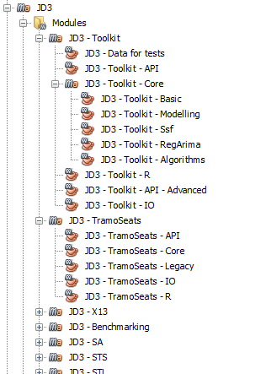
1.2 JDemetra 3.0. New design (cont.)
15 projects
Separate release schedules
70 modules
TODO
Graphical interfaces
JD+ GUI
Plug-ins
R modules
WEB-services

Slide 8
2. Many new algorithms
Time series
General time series (also daily, weekly, irregular periods, time points…)
Matrix computation (→Lapack-like)
More stable algorithms
Polynomials (roots…)
More robust algorithms (needed for high-frequency series)
State space framework
Numerous improvements (multivariate models…)
…
Conclusion: many details changed → Need for advanced testing

Slide 9
3. JD+ 3.0 and Protobuf
Protobuf (see https://developers.google.com/protocol-buffers )
Protocol buffers are Google's language-neutral, platform-neutral, extensible mechanism for serializing structured data
JD+ 3.0
RJD+ 3.0
Python
JD+ 3.0-IO
C#
JD+ 3.0 .proto

Slide 10
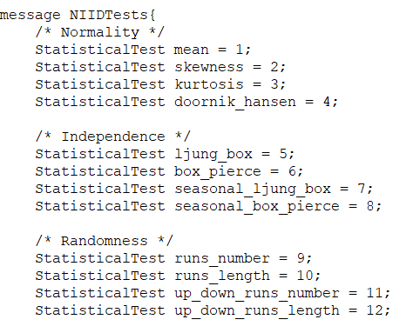
3.1 JD+ 3.0 and Protobuf (cont.)
Proper definition of the I/O
Same interface for all languages
Automatic code generation
High-performance
Fastest=1 | RJD+ (rJava) | RJD+ 3.0 (Rprotobuf)
Tramo (TRfull) | 5 | 1
TramoSeats (RSAfull) | 8 | 1.5
RegArima (RG5) | 6 | 2
X13 (RSA5) | 11 | 3

Slide 11
4. Short term actions
Tests of the main routines
TramoSeats, X12: some differences are unavoidable (should be < 10% of the series)
Benchmarking, temporal disaggregation
Through their R-interface
Validation of the I/O messages
Currently only for TramoSeats, X12
What do you really need?
R packages:
RJDemetra3, RJDBench (examples in testrjd3 and testrjdbench), currently on https://github.com/palatej

